Slide 1
Fundaçao Francisco Manuel dos Santos
PORTUGAL’S PARTICIPATION IN EU DECISION-MAKING
Professors RICHARD ROSE & ALEXANDER TRECHSEL
Robert Schuman Centre
European University Institute Florence
Brussels 3rd February 2015

Slide 2
2
28.01.15
ABSOLUTE AND RELATIVE MEASURE OF HARD NATIONAL RESOURCES
Indexes calculated as a country's absolute value divided by the absolute value of the median EU country and multiplied by 100.
Source: Eurostat. Population as 1 January 2011. GDP per capita Purchasing Power Standard 2012.

Slide 3
3
28.01.15
EU PROPOSALS AFFECTING PORTUGUESE MINISTRIES
Number of proposals
Source: As calculated by the authors from ordinary and special legislative proposals, covering the year 2012, as reported in the Legislative Observatory, available at: http://www.europarl.europa.eu/oeil/home/home.do. Where a DG’s concerns affect more than one ministry, measures are counted more than once.

Slide 4
4
28.01.15
HOW THE EU BUDGET AFFECTS MEMBER STATES
Source: 2012 figures, http://ec.europa.eu/budget/figures/interactive/index_en.cfm

Slide 5
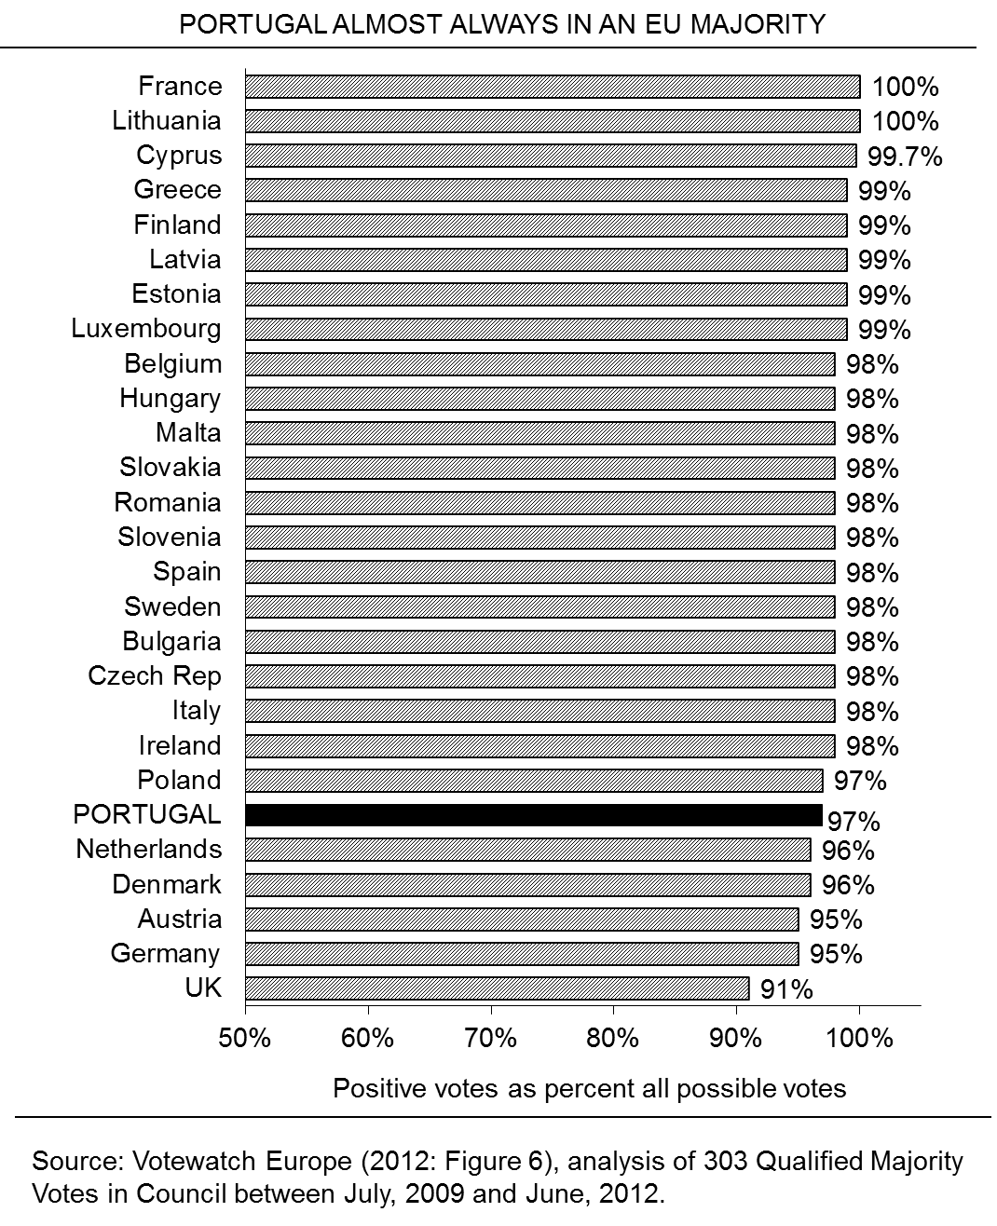
5
28.01.15

Slide 6
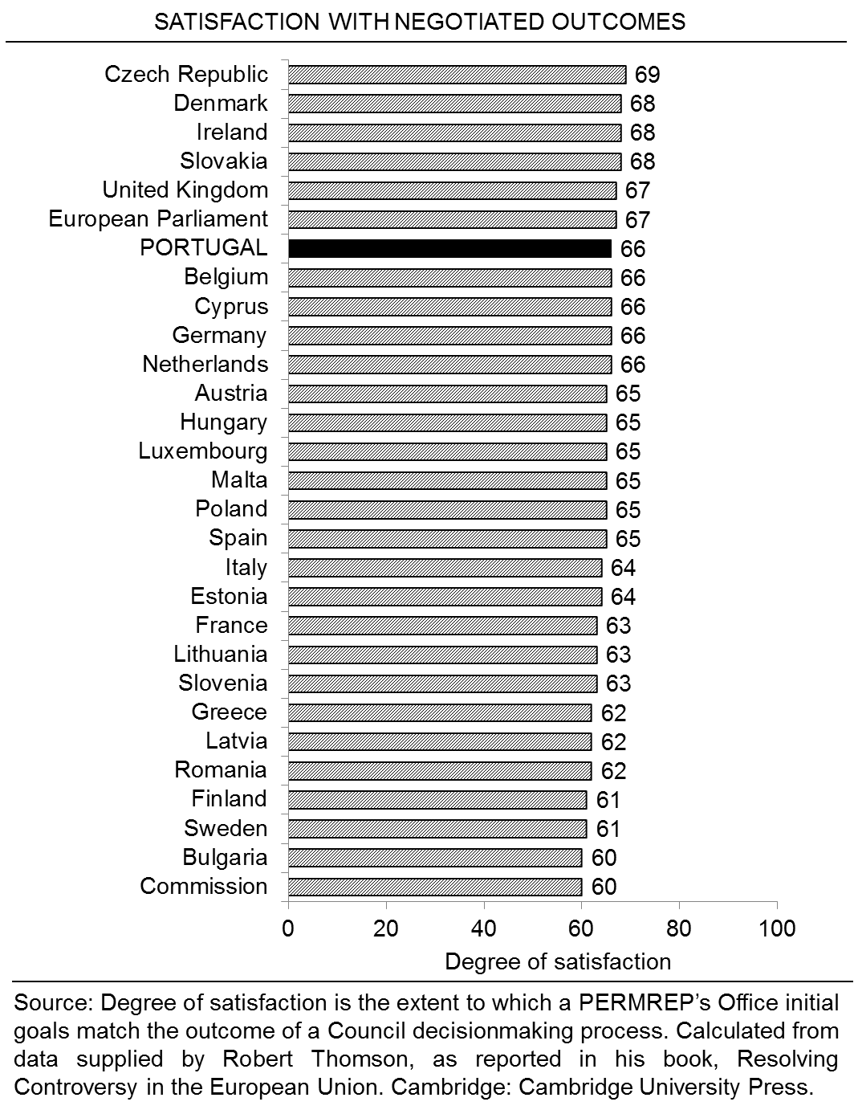
6
28.01.15

Slide 7
7
28.01.15
PARTISAN COHESION STRONGER THAN NATIONAL COHESION
 | Loyalty EP Party Group | Loyalty Country Group
 | Mean | Mean
2009-2014 | 0.93 | 0.78
2004-2009 | 0.95 | 0.82
Source: Votewatch.eu. Calculations computed by the authors.

Slide 8
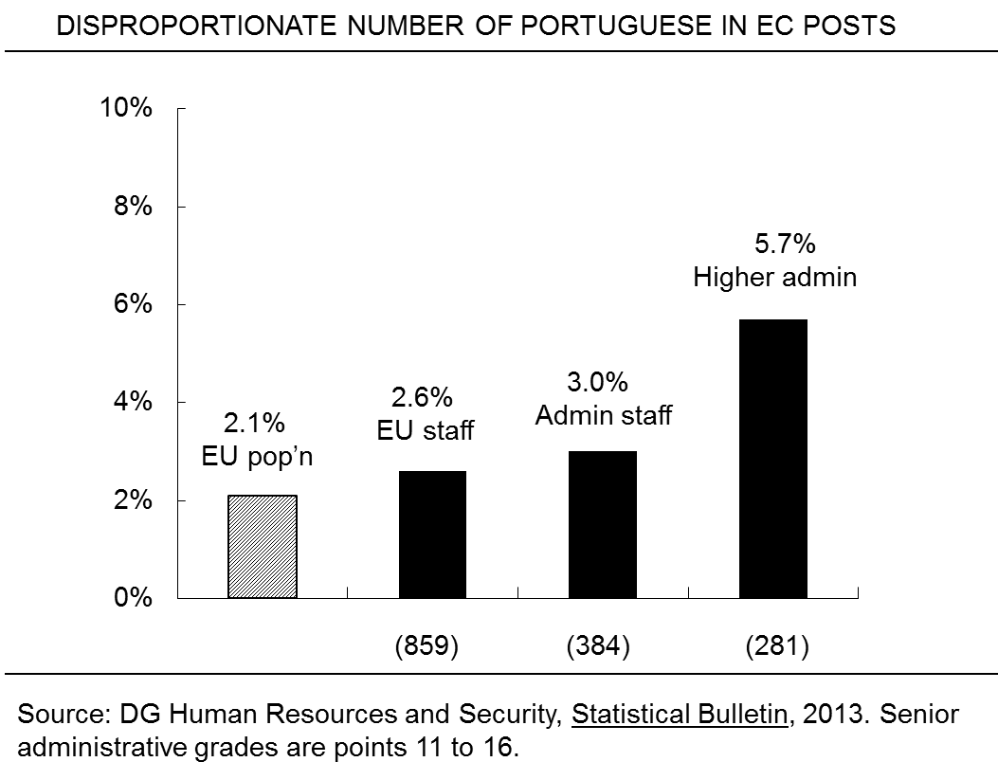
8
28.01.15

Slide 9
9
28.01.15
CHALLENGES FACING PORTUGAL
*The EU's consensus norms mean big states must consult with smaller states but a consensus does not require consulting with each smaller state.
*Since Portugal joined the EU, enlargement has more than doubled the number of smaller member states making each at risk of being lost in a crowd.
*Portugal needs to emphasise common interests not just national interests in order participate in coalitions with more than a dozen other member states, large and not so large.
*To keep national and EU policies aligned, the Portuguese Permanent Representative’s Office in Brussels must be in constant contact with Lisbon--and vice versa.
*To cultivate political influence, more Portuguese MEPs should serve at least two terms in the European Parliament.
*To work effectively in an interdependent European political economy, Portuguese need education and experience in working in multi-national setting as well as Lisbon.

